Slide 1
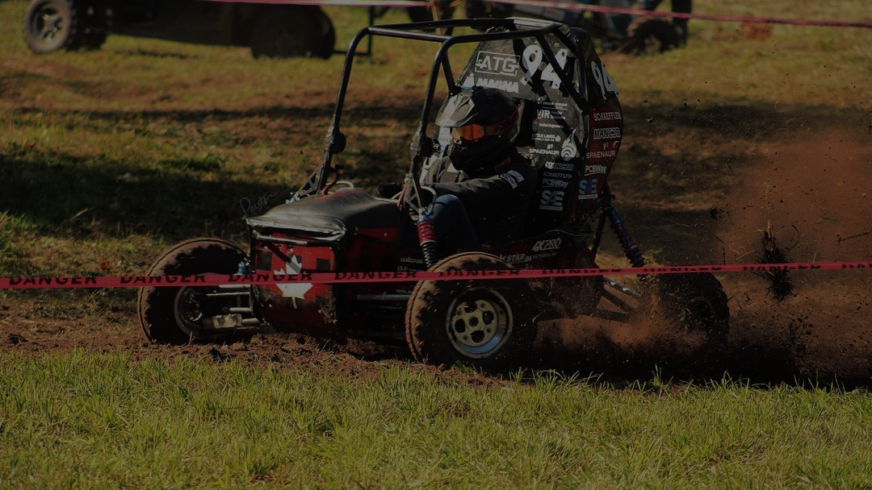

CVT – Simulator
Team 17 – Baja Dynamics

Slide 2

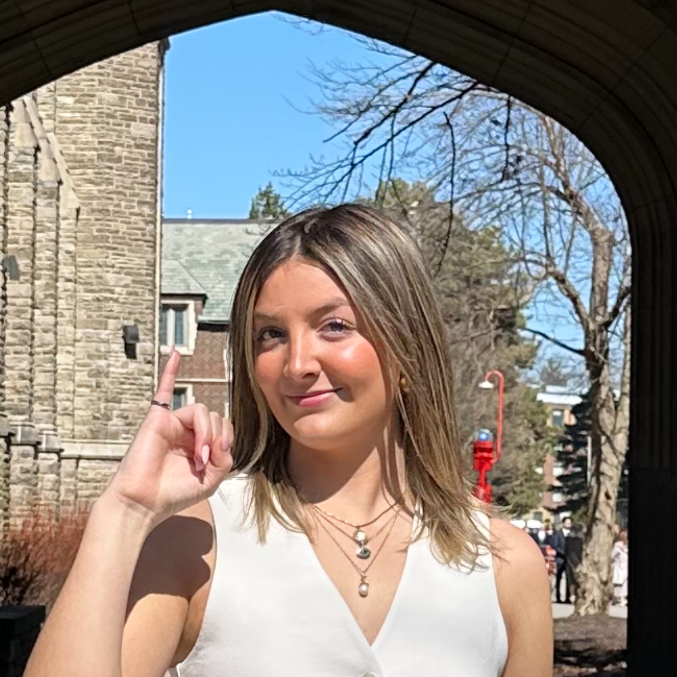
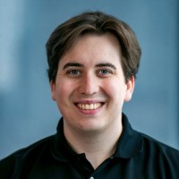


Team Members
Grace McKenna
Travis Wing
Cam Dunn
Kai Arseneau
Our Supervisor: Dr. Spencer Smith

Slide 3
Roadmap
Introducing Problem
Our Solution
Key Requirements and Objectives
Demo
Results
Future Features and Next Steps

Slide 4
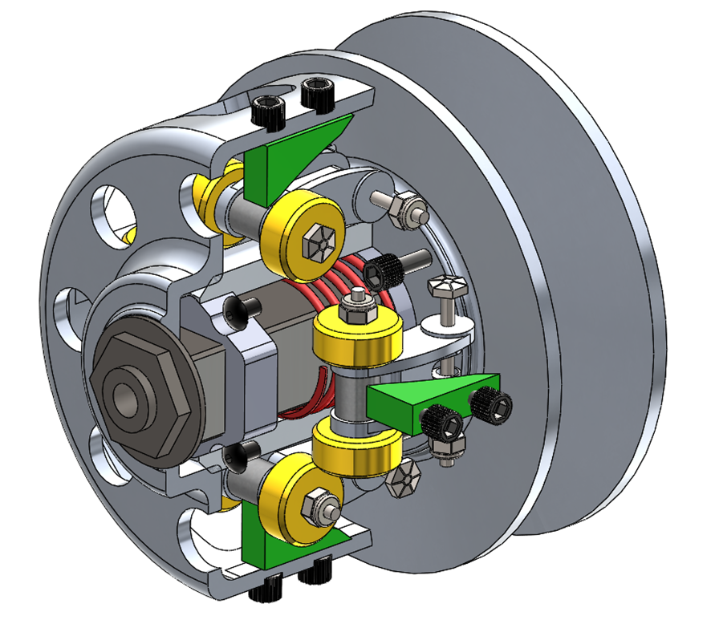
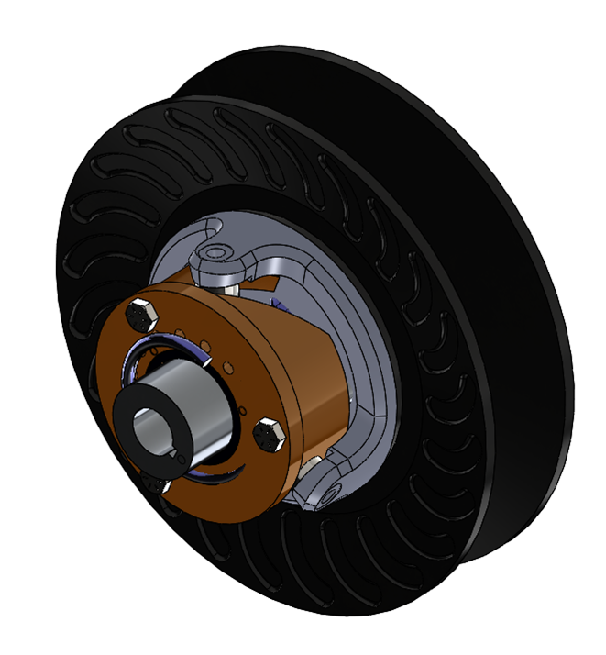
Current Problem
CVT is the Core of the Powertrain
Transfers engine power; critical for acceleration, hill climb, endurance
Directly impacts >50% of competition points
Current CVT Setup: Complex + Costly
~10 tunable parameters + many design variables
8+ weekends spent tuning last season with great sucess
Still underperforms (e.g., ETS ~20% faster in acceleration)
Challenges:
Manual tuning is time-intensive + manufacturing-heavy (e.g., wire EDM)
Limited drive time + partial understanding of performance metrics
Primary CVT
Secondary CVT
Notes:
Talking points:
The CVT, being the McMaster Baja's transmission, is in charge of as much power from the engine as possible. This marks it as arguably the most important aspect of the vehicles powertrain, of which the performance directly correlates to some key events in the official competition, being hill climb, acceleration and endurance (4 hour race). Together these make up well over 50% of the available points.
Issue is our mechanical CVT is incredibly complex, with (check num) 10 tunable parameters and many more design choices.
Last year, CVT tuning took up over 8 weekends of work even with formalized testing and tools to help adjust parameters quickly – despite that, performance is still left on the table (look at ETS, who is like 20% quicker than us in accel runs) Obviously there are metrics we fail to understand fully, and with the limited drive time the team has each season, alongside expensive manufacturing (wire EDM- wire burning machine metal technique used to build ramps for example), manual tuning is quite costly!

Slide 5
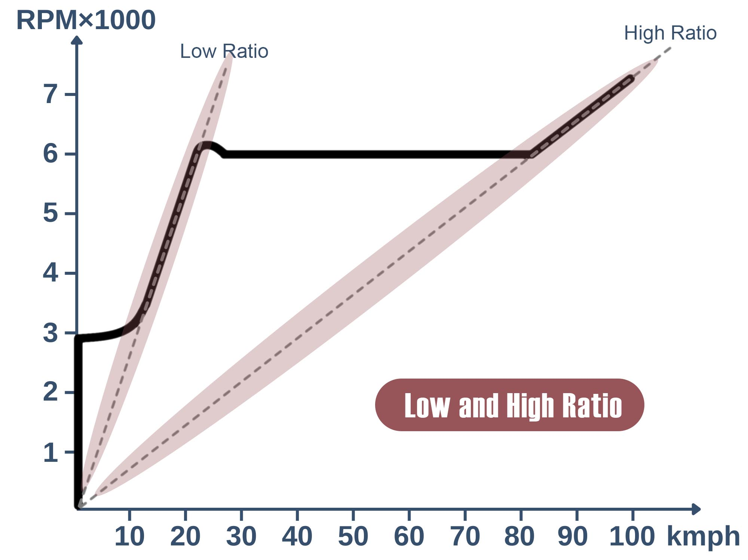
Our Solution
Proposed Solution: Holistic Powertrain Model
Simulates engine, CVT, resistive forces, and gearbox
Enables rapid, cost-free iteration
Improves understanding, guides smarter tuning & design decisions
Enable users to test different tuning parameters
Our Goal: Develop a simulation tool to virtually tune CVT parameters and test their impact. To figure out the optimal tuning parameters and improve vehicle acceleration and hill-climbing performance.
Notes:
Solution: Develop a holistic model of the powertrain of the Baja vehicle, modelling resistive forces and the engine, all delivered through the CVT
By doing so, it allows the team to understand how changes to each portion affect the whole, and model these quickly and for effectively 0 cost – This will not only lead to faster iteration, but also a better understanding of each portion, which can further drive design changes as well

Slide 6
Key Requirements
Simulation & Core Calculations
Simulate the McMaster Baja Team’s CVT (Continuous Variable Transmission) using mathematical models.
Compute primary and secondary clamping forces based on CVT parameters.
Calculate acceleration, velocity, and distance of the car.
User Interface
Allow users to adjust CVT tuning parameters
Other parameters such as vehicle weight, driver weight, traction, and the incline angle can be changed.
Output & Visualization
Provide the user an interface to play and view the simulation results
Display graphs of simulation results.
Enable export of the simulation data

Slide 7
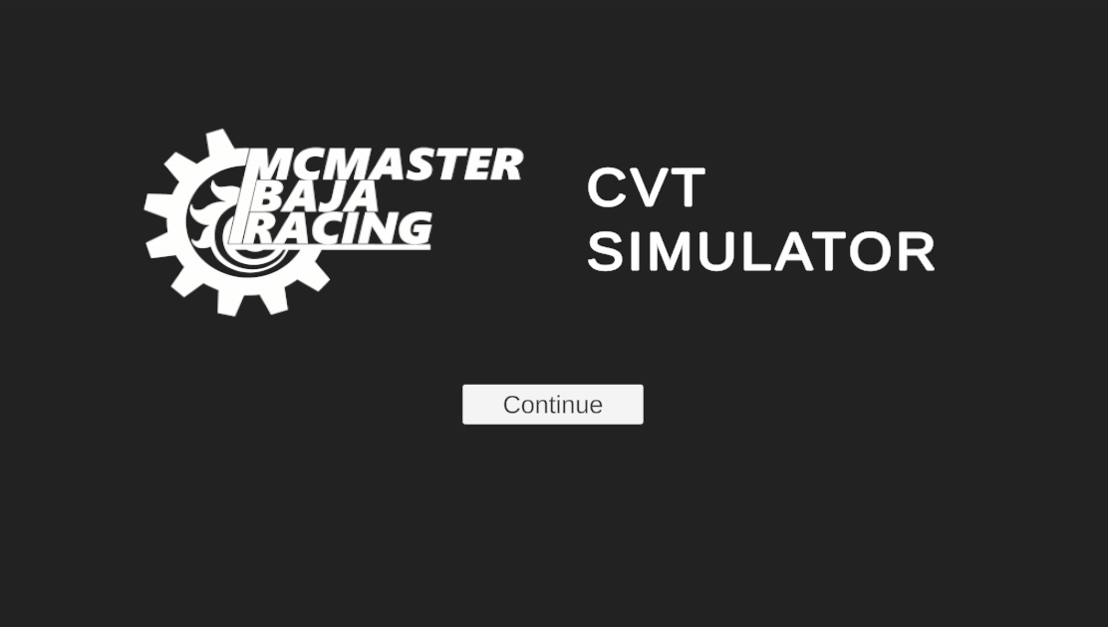
Demo

Slide 8
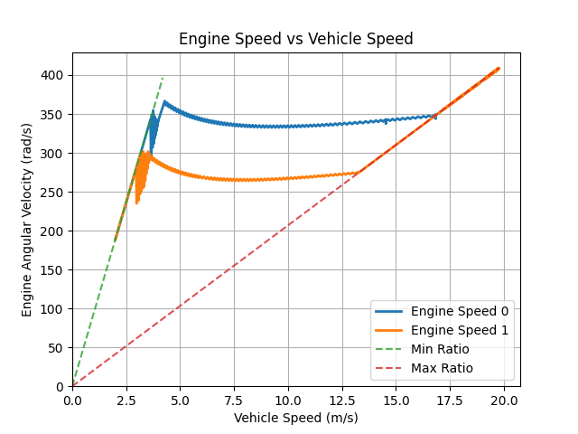
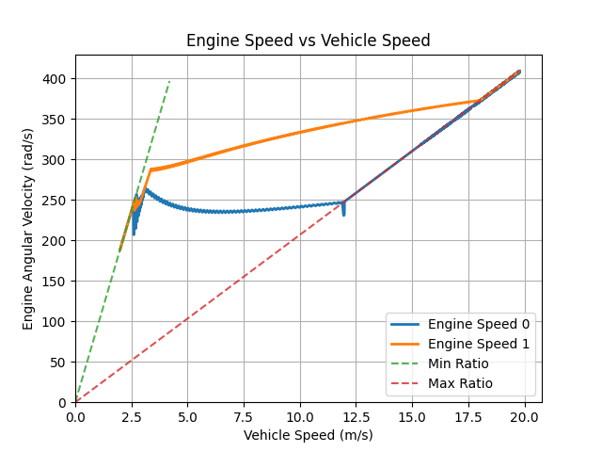
Trend Analysis
Differing Weights
Differing Spring Rates

Slide 9
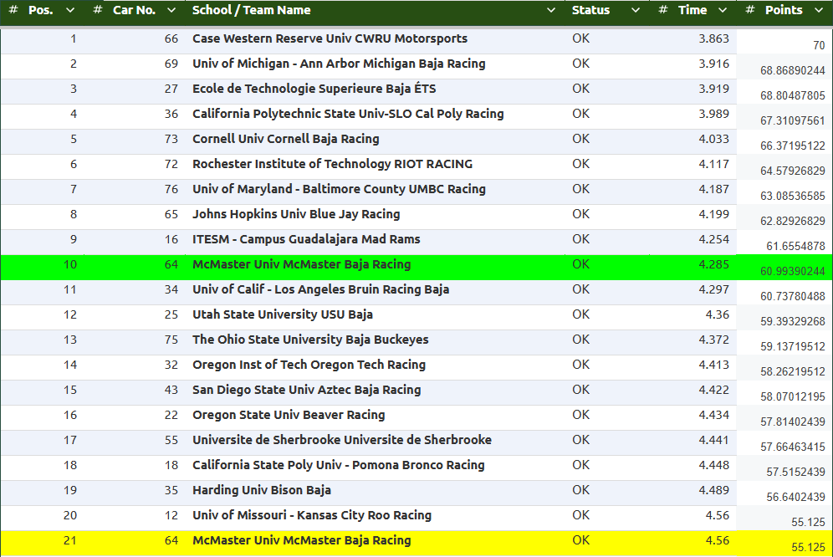
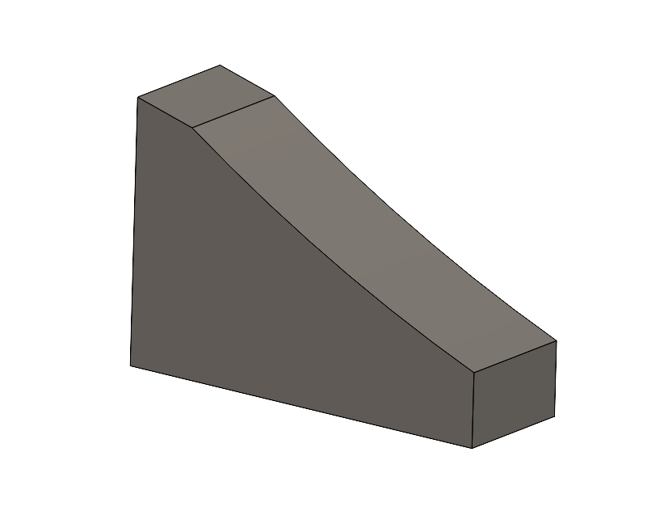
Results

Slide 10
Next steps and future features
Removing Key Assumptions
No Belt Slippage
System overpredicts torque transfer and grip reliability.
Future fix: simulate slippage based on friction.
No friction on non-critical components
Results in inaccuracies through various resistive / dampening forces when shifting. Further also easy to quantify
Dynamic loading scenarios
Incorporating more dynamic slopes (e.g. flat then hill) rather than only a single angle allows us to simulate backshifting, another integral behaviour of the CVT
UI Improvements
Feedback through usability testing

Slide 11

Thanks for Listening!
CVT-Simulator - Team17

